Slide 1
Data Drift

Slide 2
Core Processes
Finetuning
Operationalization
Automation
ML Lifecycle
Experiment Tracking
Architecture Design
MLOps Fundamentals
Deployment scenarios
Modularization
Model Drift
MLOps Level 1
Infrastructure management
ML Pipelines
AutoML
MLOps Level 2
Data and Model Versioning
Conteinarization

Slide 3
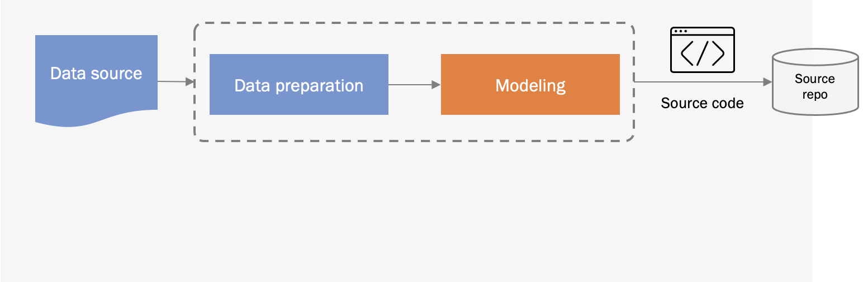
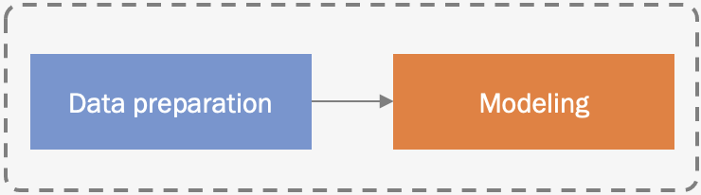
Model experimentation and development
CI/CD
Pipeline building and testing
Packages
CD Pipeline Deployment
Feature store
Model update cycle
Model serving
Continuous Deployment (CD)
Model repo
Data validation
Data preparation
Model serving
Scaling
Logging
Monitoring
Trigger
Model monitoring
Model API
Live data

Slide 4

Model experimentation and development
CI/CD
Pipeline building and testing
Packages
CD Pipeline Deployment
Feature store
Model update cycle
Model serving
Continuous Deployment (CD)
Model repo
Training
Validation
Data validation
Data preparation
Model serving
Scaling
Logging
Monitoring
Trigger
Model monitoring
Model API
Live data

Slide 5
Prediction service

Slide 6
Prediction service

Slide 7
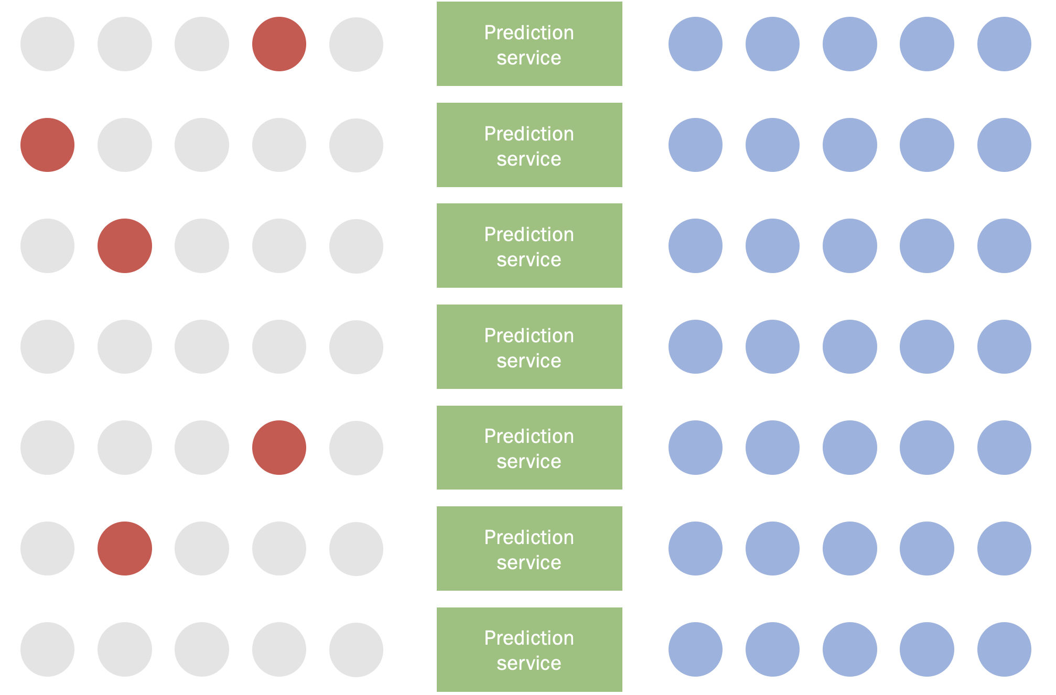
With hundreds of models in production…
We need to automate data validation

Slide 8
What may go wrong?

Slide 9
1
The distribution of data (inputs and labels)
2
Change in schema
What may go wrong?
3
Relationship between features and labels
4
A data source (eg maintained by others)
5
An upstream model

Slide 10
Gender
Male
Changes in data distribution
Female
!
Changes in the likelihood of observed values
Male
Female

Slide 11
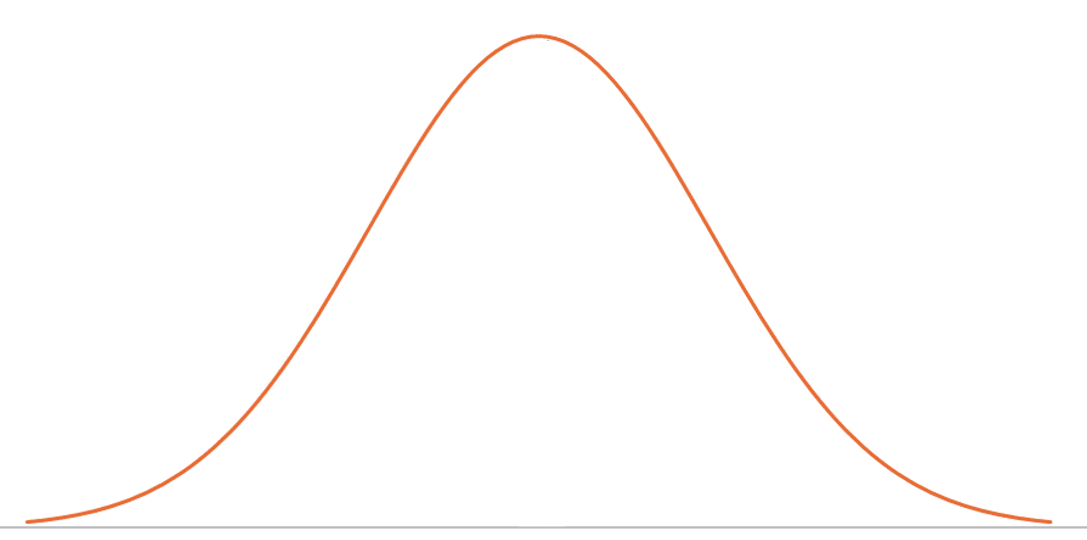
Changes in feature distribution: numerical
!
Standard deviation shift

Slide 12
Changes in feature distribution: numerical
!
Mean shift

Slide 13
Gender
Male
Changes in feature distribution: categorical
Female
!
Distribution
Male
Female

Slide 14
Gender
Male
Changes in feature distribution: categorical
Female
!
Schema: new value of an existing feature
Male
Female
Non-binary

Slide 15
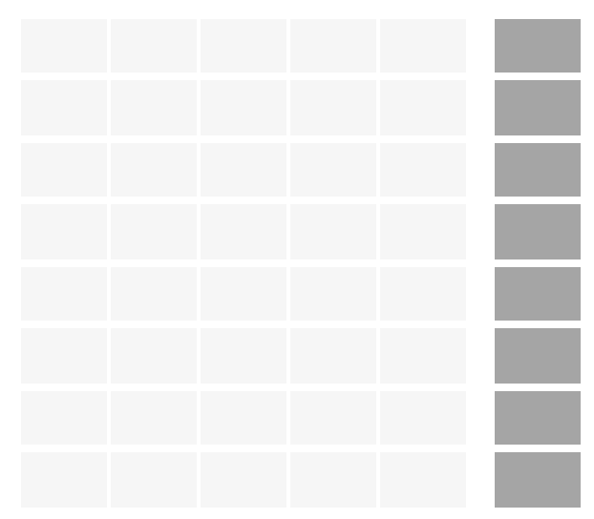
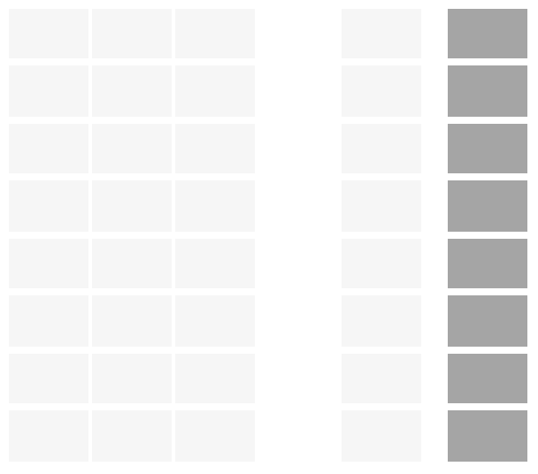
Changes in feature distribution: categorical
!
Schema: missing feature

Slide 16
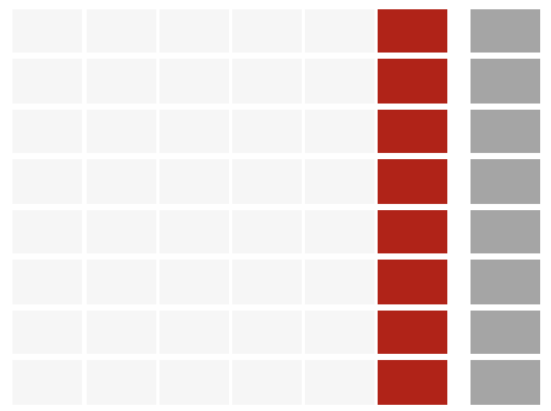
Changes in feature distribution: categorical
!
Schema: extra, new feature

Slide 17
High_rev
High_rev
Changes in label distribution
Low_rev
!
Our model's predictions typically match the distribution of the labels in the training set: change in label distribution will make the model significantly less accurate
High_rev
Low_rev

Slide 18
Relationship features <> labels

Slide 19
Correlated
with Causal
Causal
Relationship features <> labels
One of the variables is in fact causal, while other are just correlated with it.
Model doesn’t know about that, and treats all the 4 features equally

Slide 20
Relationship features <> labels
One day, the other features decouple (world is changing), but model is not aware of it… Its performance decreased
This is so called Model Drift

Slide 21
Input
Model
Output
Change in the data source
One day, an update to GUS/Stat data source changes format of the data…
Age_first_order
Gender
Geolocation
User Agent
Transactions
Demographics enrichment
...

Slide 22
Input
Model
Output
but also change in the library…
One day, an update to user_agent library changes its output format…
Age_first_order
Gender
Geolocation
User Agent
Transactions
...

Slide 23
Input
Model
Output
Change in the upstream model

Slide 24
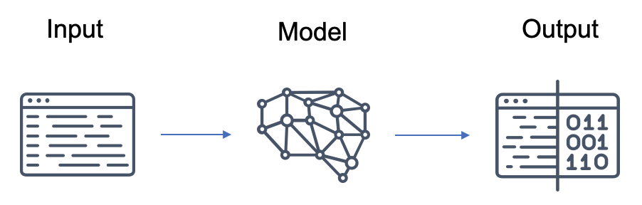
Change in the upstream model

Slide 25
Customer behavior
Change in the upstream model
One day, „customer age” modeling team fixes the model, and…
Product recommendation
Customer age

Slide 26
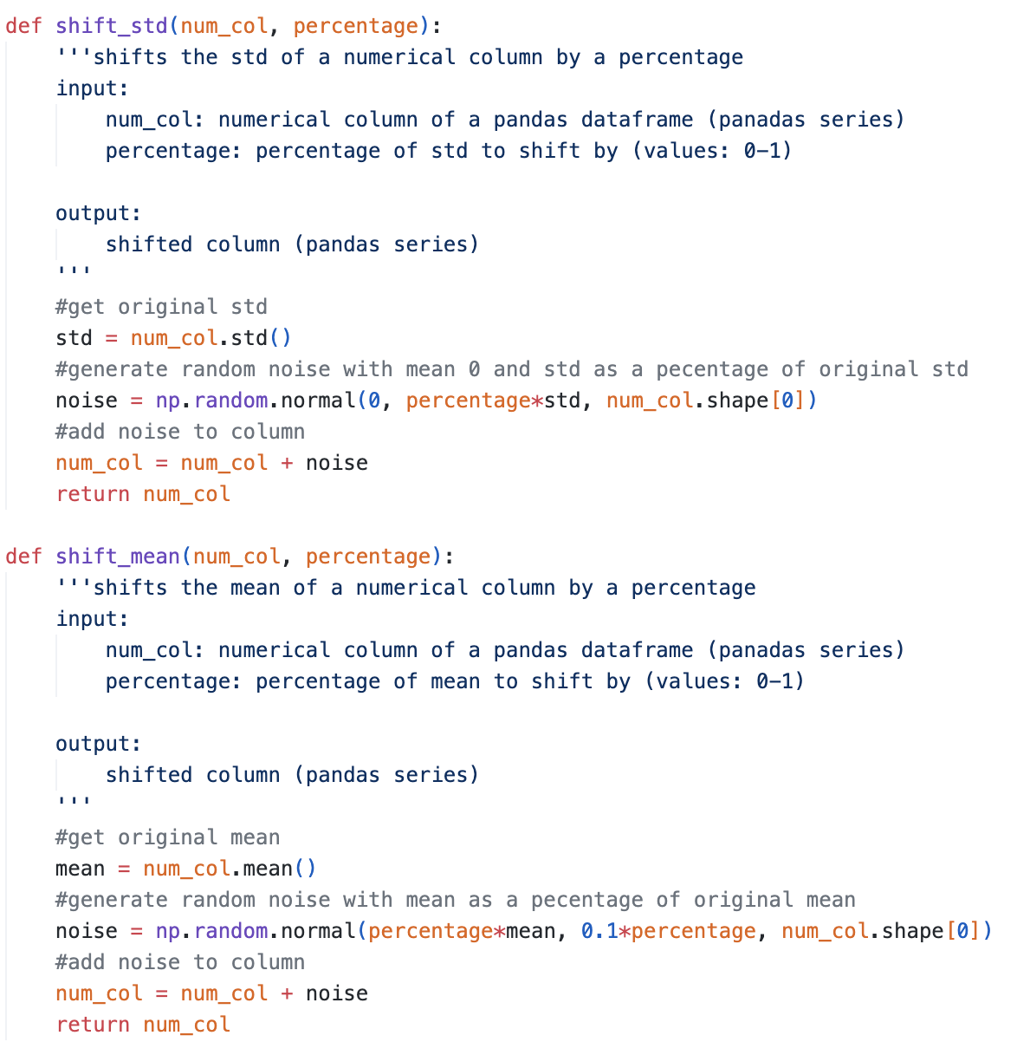
Let’s simulate some data skew…

Slide 27
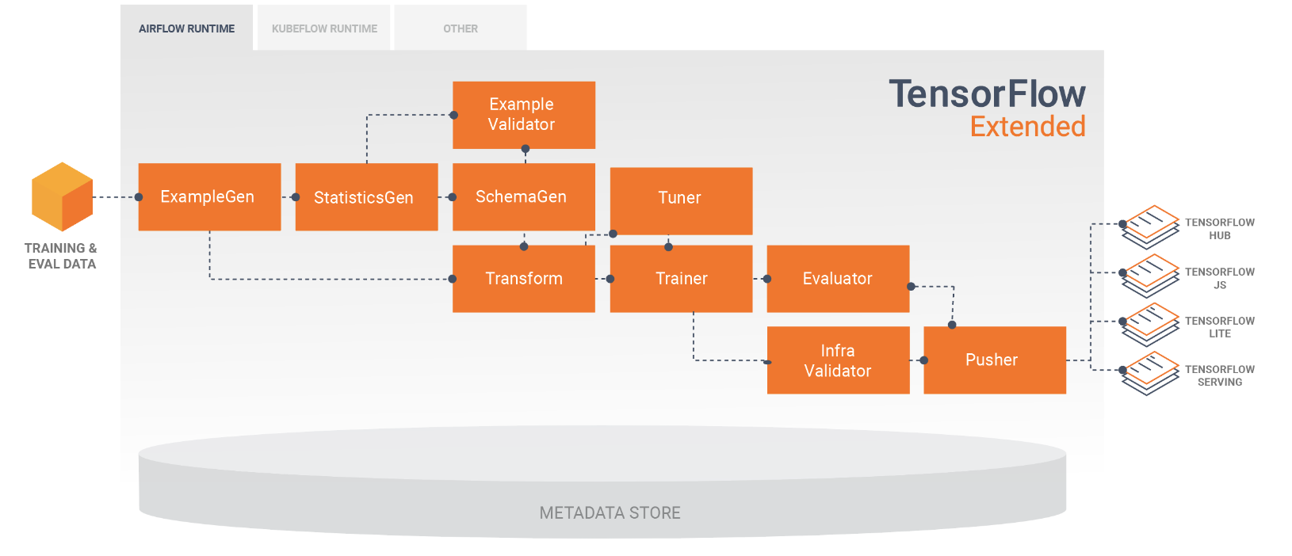
TensorFlow eXtended (TFX)

Slide 28
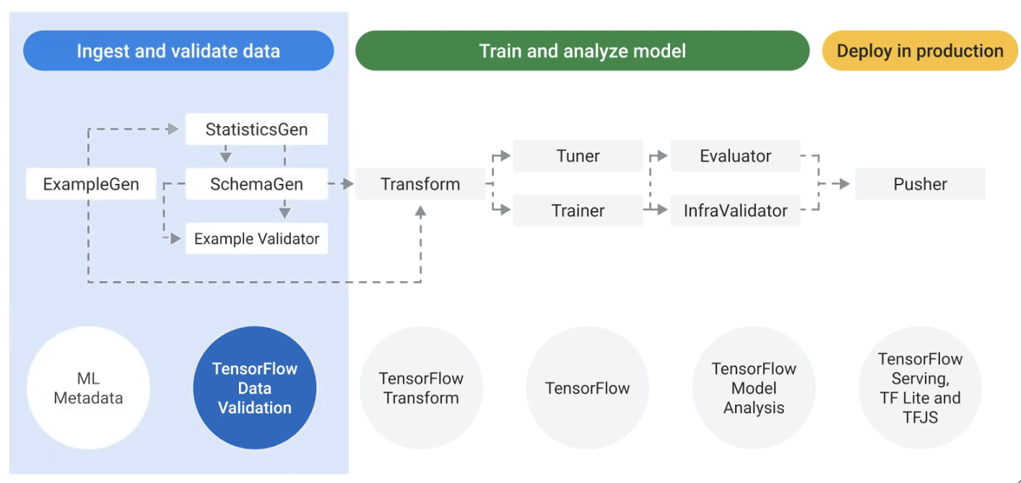
TensorFlow Data Validation (TFDV)

Slide 29
Detect distribution skew between training, testing, validation and serving data
Data distribution in training
Data distribution in testing data splits
Data distribution in validation
Data distribution in serving
skew
skew
skew

Slide 30
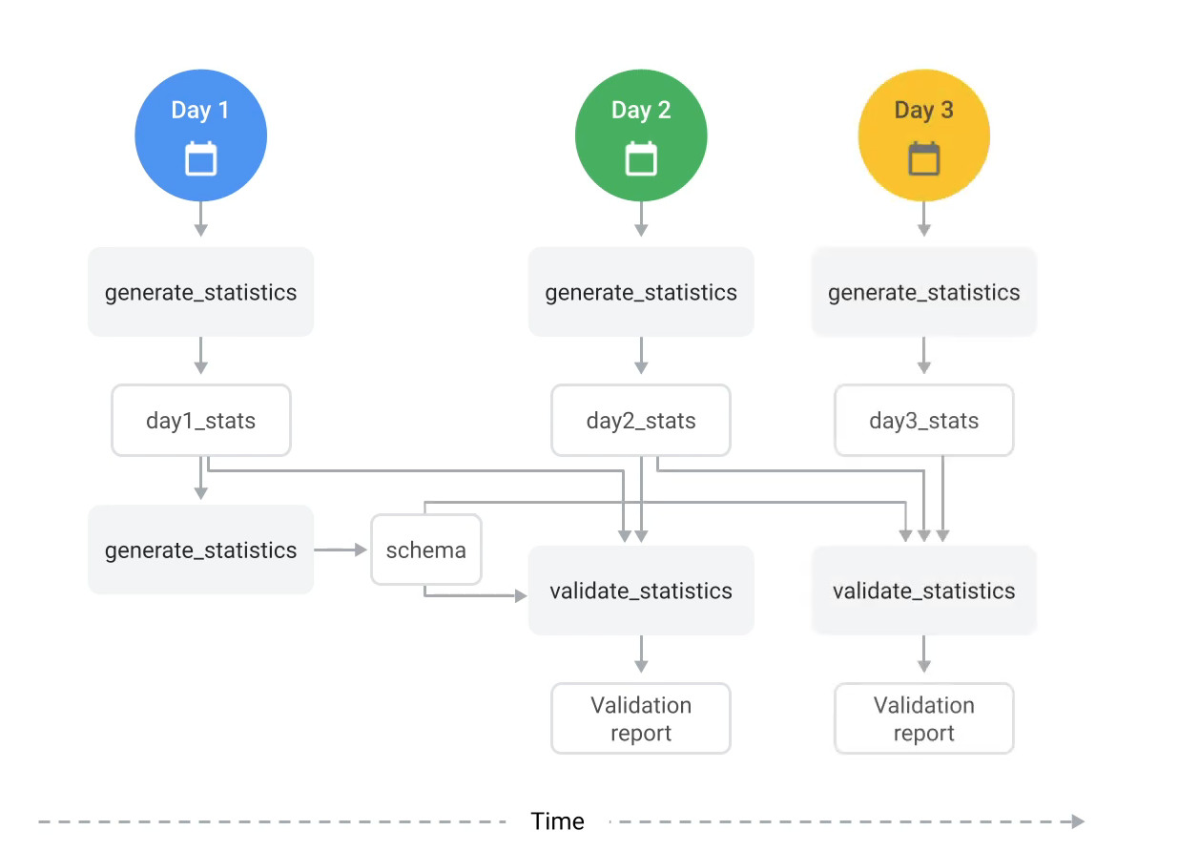
Validate continuously arriving data

Slide 31
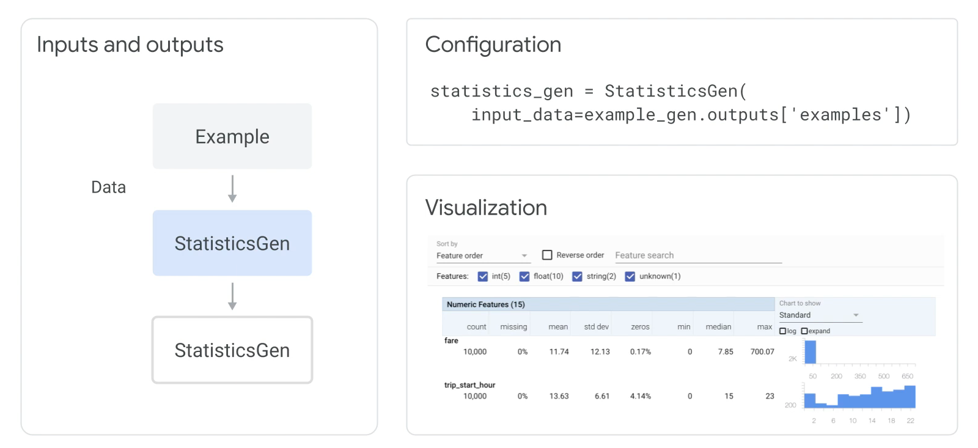
StatisticsGen Component

Slide 32
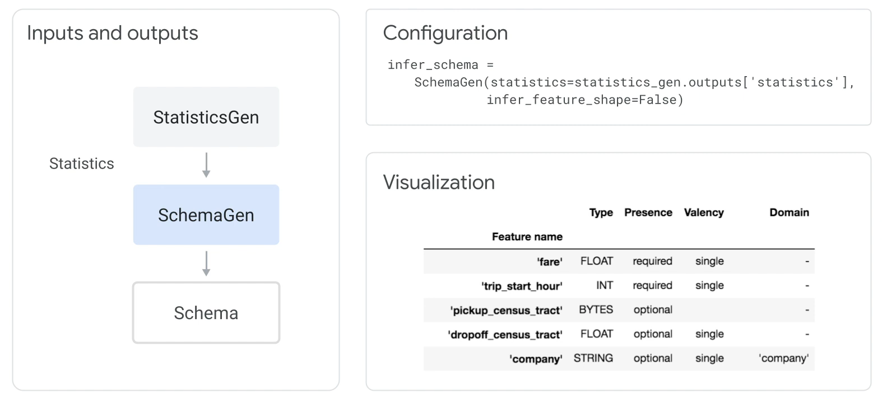
SchemaGen Component

Slide 33
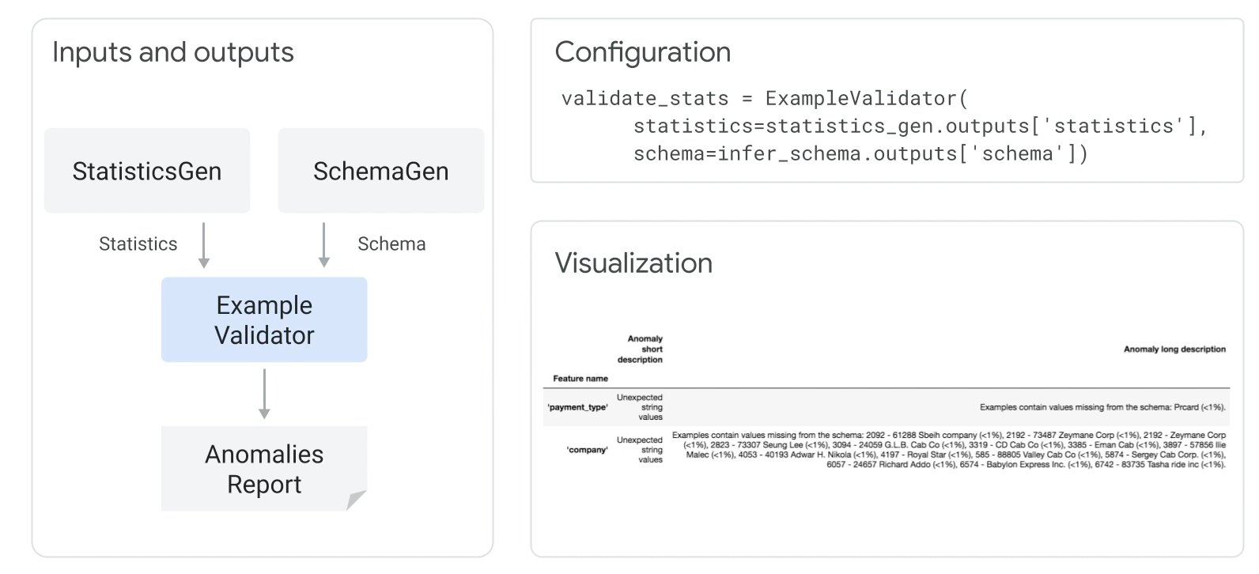
ExampleValidator Component

Slide 34
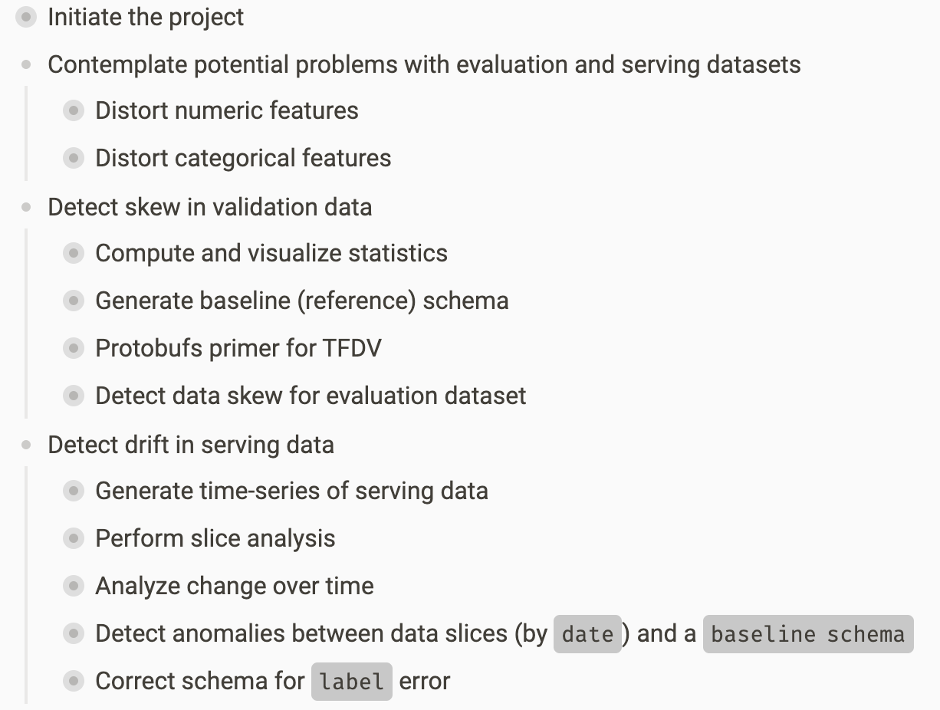
Our Workflow

Slide 35
Auxilliary tools

Slide 36
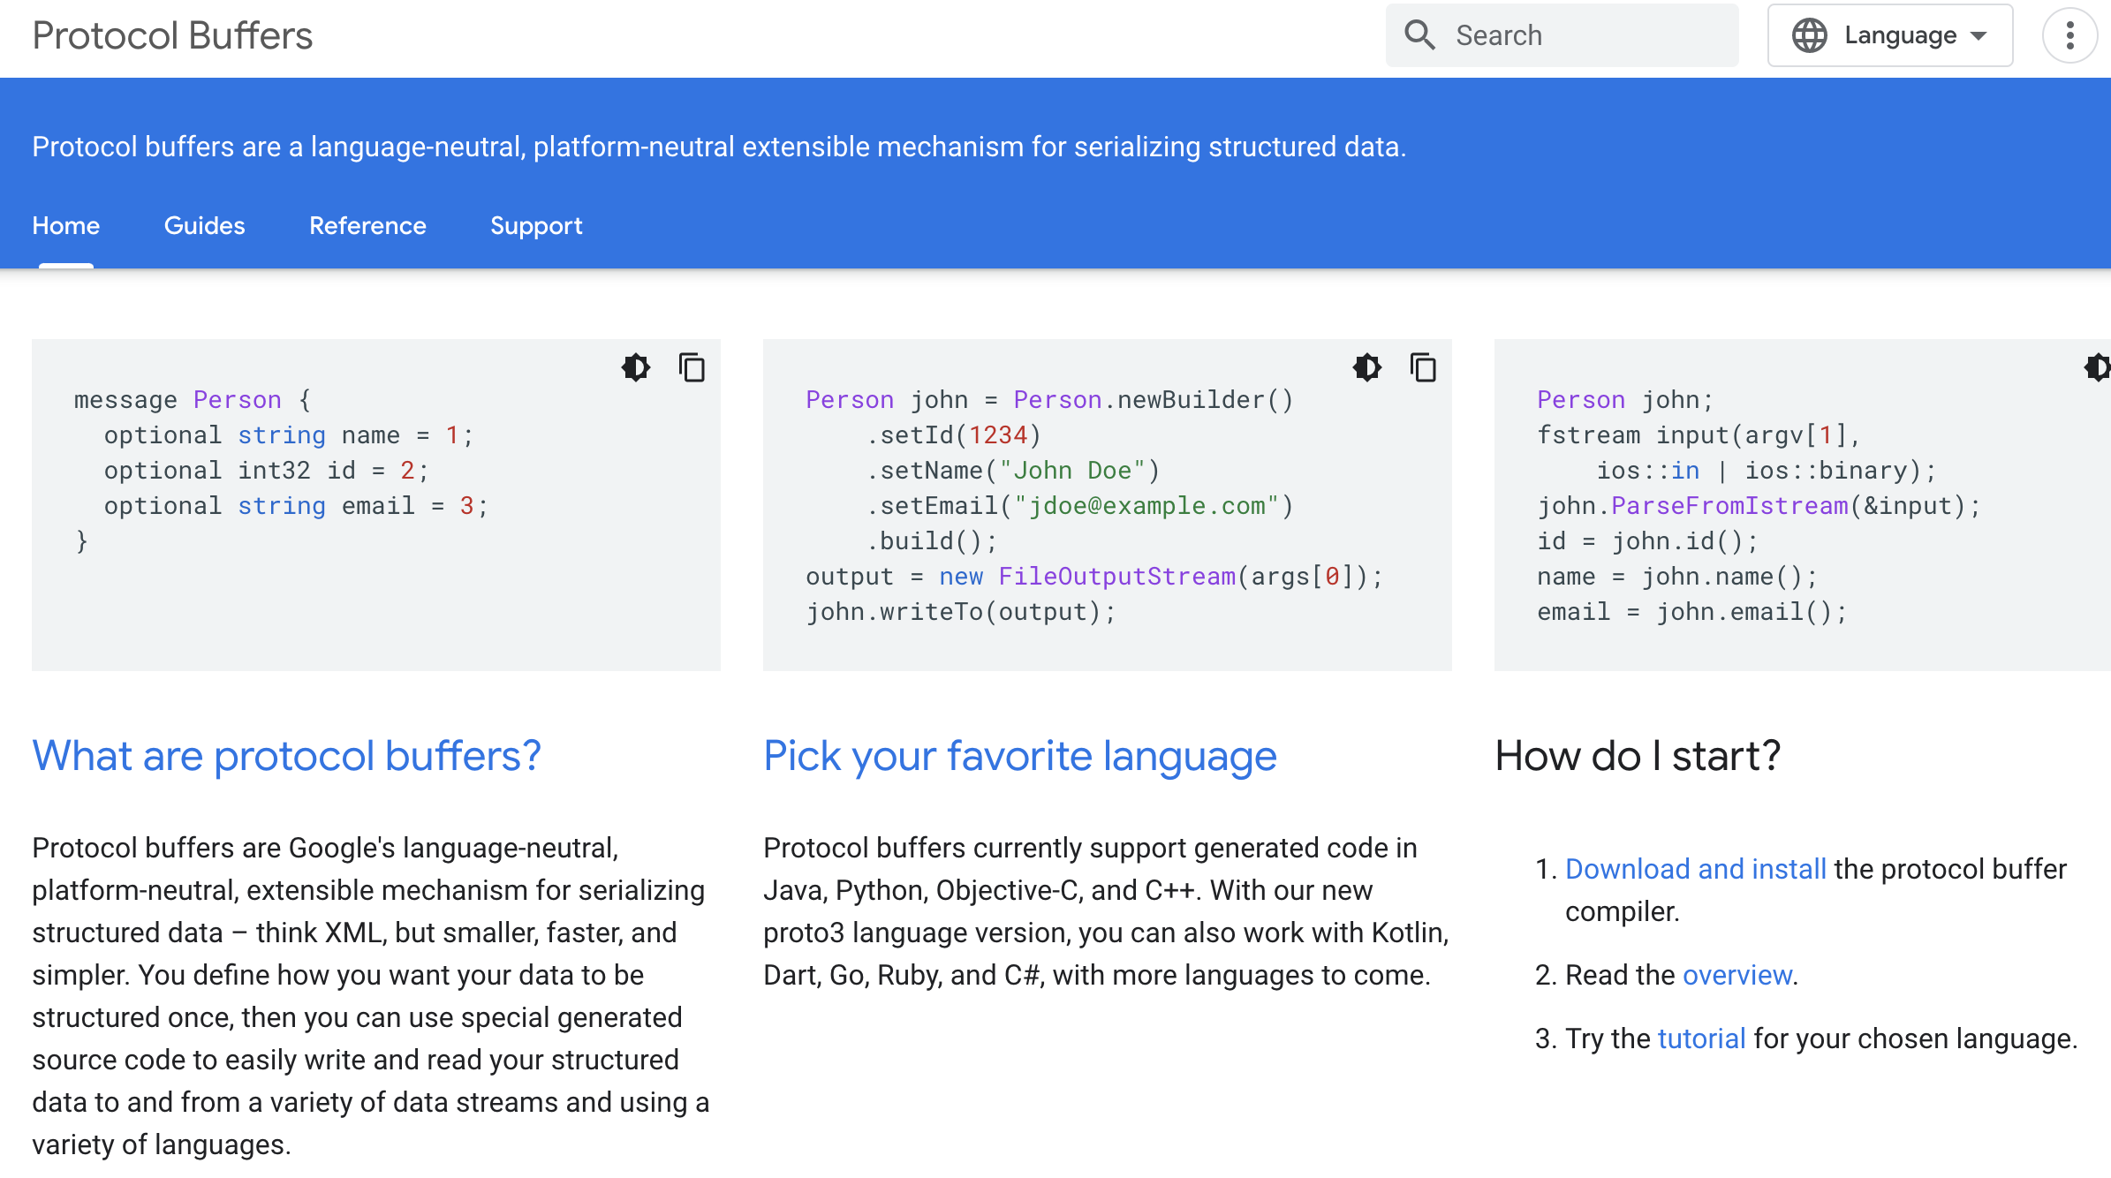
Protobuf

Slide 37
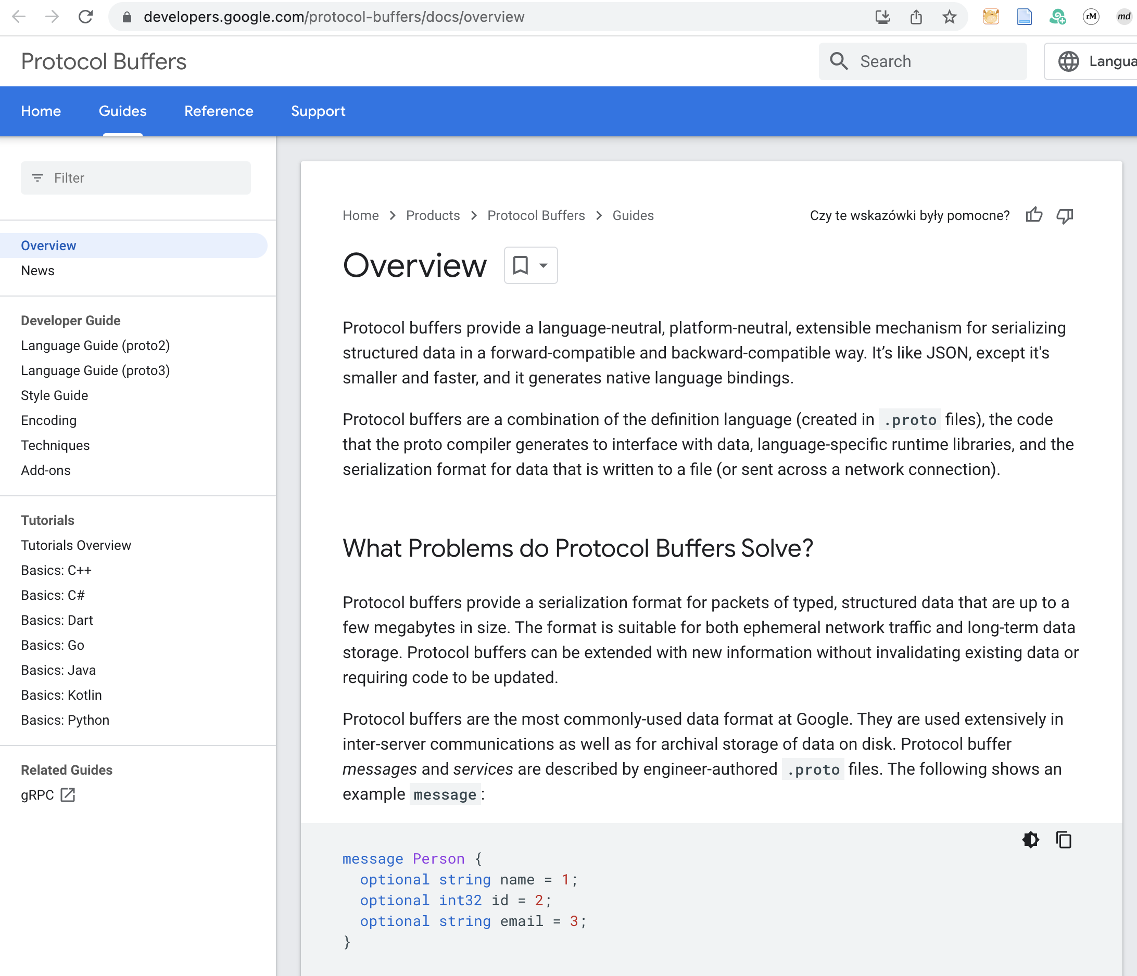
Protobuf

Slide 38
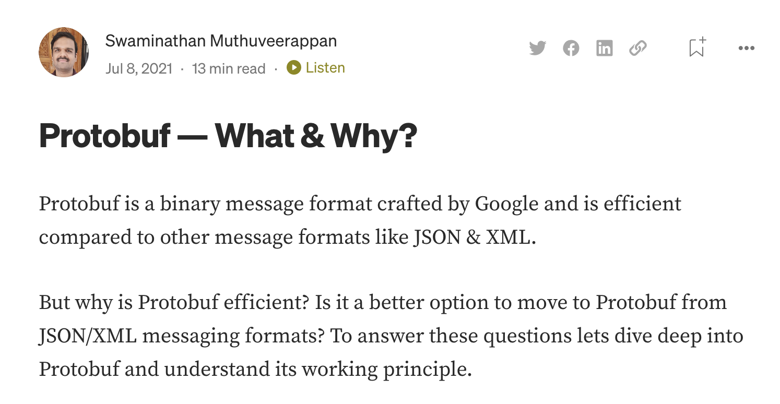
Protobuf

